Slide 1
Pest Management System
Provided by the LAUSD Food Services Division
Notes:
Read: Hello and welcome to the Pest Management Reporting Guidelines.

Slide 2
Protecting Our Students
Protecting the health of children is a top priority.
Integrated Pest Management contributes to a healthy environment where students can thrive.

Slide 3
Objectives
This training will discuss the following areas:
Pest reporting escalation process
How to report pest activity in the cafeteria
FSM/AFSS pest report access
Notes:
READ:

Slide 4
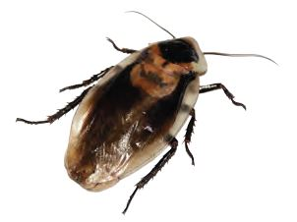
Pest Activity Reporting
Report pest activity in the cafeteria immediately!
Rodents
Roaches
Ants
URGENT
Pest activity from rodents, roaches, and ants is classified as urgent.
Notes:
READ:

Slide 5
Pest Activity Follow Up
It is possible an inspection will take place outside regular business hours.
A 24 to 48 hour response is required for rodent, roach, and ant activity.
Check the pest management report system to see if there is an inspection in progress.

Slide 6
Escalation to AFSS
If there is no inspection within 24 to 48 hours contact your AFSS.
The AFSS will contact the Senior Pest Technician for the area.
South
North
David Lerma
David.lerma@lausd.net
(323)789-5000
Jose Medina Jose.medina1@lausd.net
(213)792-5254
Central
East/West
Miguel Enriquez
Miguel.enriquez@lausd.net
(213)745-1400

Slide 7
Keeping Pests Out of the Cafeteria
Managers train their employees to recognize signs of pests.
All food service employees have a responsibility to identify and report pest activity in the cafeteria.
FSW will inform their manager if they suspect pest activity in the cafeteria or surrounding areas.

Slide 8
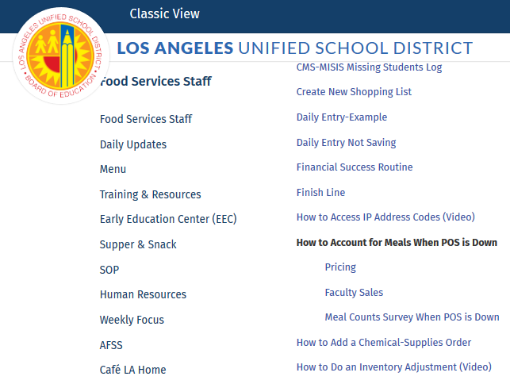
Reporting Pest Activity
To submit M&O requests, go to the Training & Resources page of the Café LA website.
Notes:
READ:

Slide 9
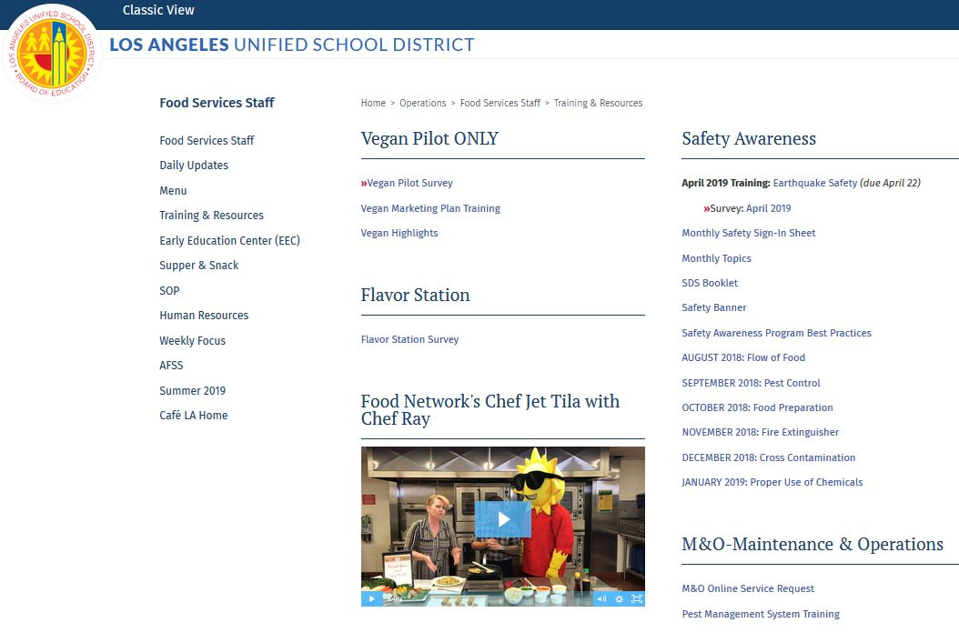
M&O Online Service Request
From M&O Maintenance & Operations
Click on:
M & O Online Service Request
Notes:
READ:

Slide 10
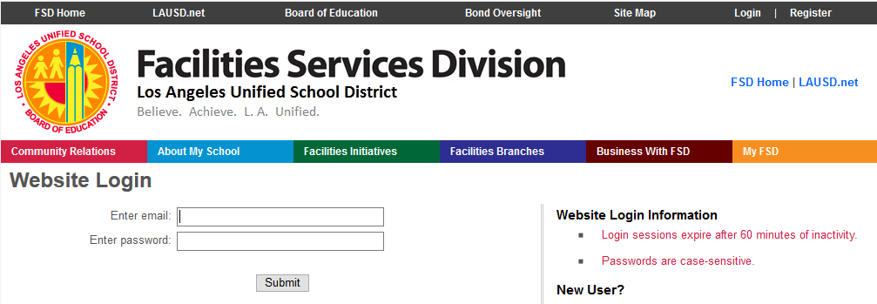
Login
msmith@lausd.net
Enter your Single Sign-on
(include @ lausd.net)
Notes:
READ:

Slide 11
M&O Login Troubleshooting
Login takes you to the FSD Service Request Page.
If permission is denied, contact your Staff Aide.
WEST/EAST - Lisa Hess
lisa.hess@lausd.net
CENTRAL - Ricky Miramontes ricardo.miramontes@lausd.net
NORTH - Michael Lewis michael.l.lewis@lausd.net
SOUTH - Preeti
ms.preeti@lausd.net
Notes:
READ:

Slide 12
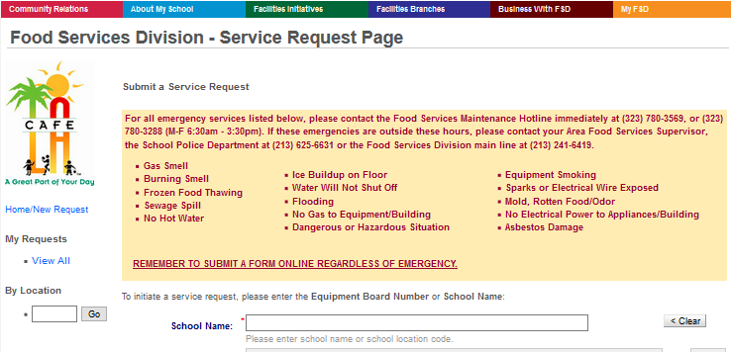
Service Request Page
REMEMBER TO SUBMIT A FORM ONLINE REGARDLESS OF EMERGENCY.
Food Service Division - Service Request Page
Notes:
READ:

Slide 13
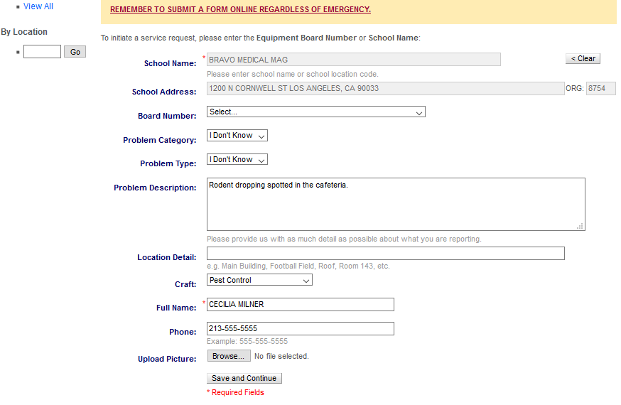
Reporting Pest Activity
Give a description of why pest activity is suspected.
Enter “Pest Control”
as the craft.
Click “Save and Continue”
Notes:
READ:

Slide 14
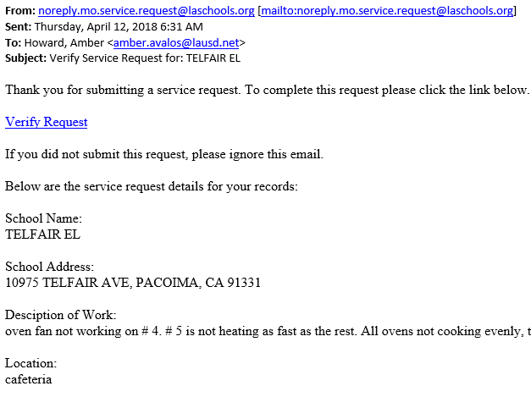
1st Email - Report Verification
Monday, January 22, 2018 9:40 AM
1st email:
Click on “Verify Request” to complete the request.
Rodent dropping spotted in the cafeteria.
The M & O verification process is completed in two emails.
Notes:
READ:

Slide 15
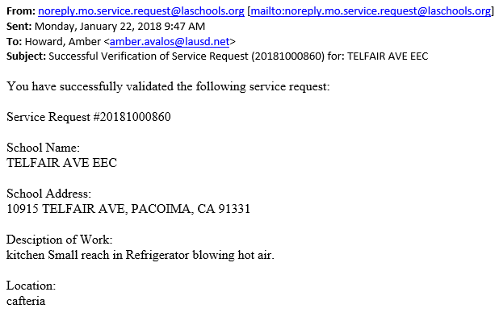
2nd Email - Report Validation
2nd email:
Confirms the successful validation of the request and provides a service request number.
Rodent dropping spotted in cafeteria.
Notes:
READ:

Slide 16
Pest Inspection Report System
Inspector will input the report into Pest Report System.
Pest Control Technician will conduct a site visit to determine the source of the pest activity.
When complete the system will provide FSM/AFSS with an email notification.

Slide 17
Email Sent from IPM
From: KONSTANTIN.KRIKUNOV@lausd.net Sent: Tuesday, June 19, 2019 4:35 PM To: Milner, Robert <rcm3057@lausd.net>; Daguro, Roxanne <rmd2053@lausd.net> Subject: PEST Inspection Report #32254 for BRAVO MED MAG
Manager, On 06/19/2019 Krikunov, Konstantin made a Monthly PEST inspection at BRAVO MED MAG You may access the report by clicking on the link below: http://facapps.lausd.net/ords/f?p=925:2:0::NO:2:P2_MAIN_ID:32254 By accessing the link above, you acknowledge that you have received and read this report. Please contact PEST Inspector if you have any questions about the report findings and corrective actions, or if you are having trouble accessing the report.
Email notifications provide a link to the Pest Inspection Report System.
Notes:
READ:

Slide 18
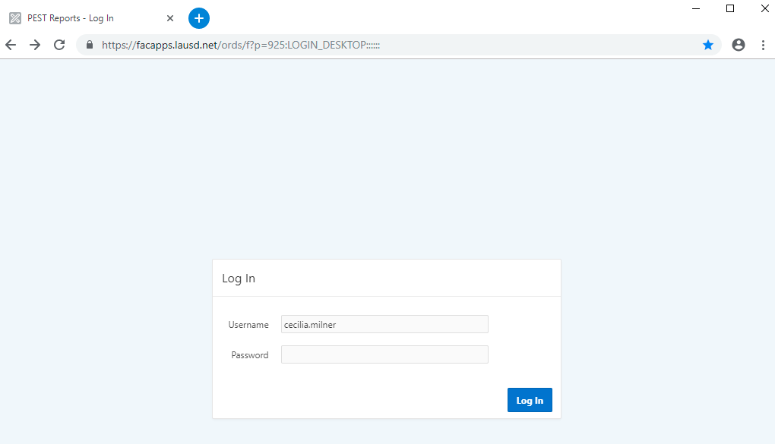
Pest Inspection Report System Login
Click on the link from the system generated email or go to:
https://facapps.lausd.net/ords/f?p=925
Enter your Single Sign-on
Do not include:
@ lausd.net
msmith@lausd.net
Notes:
READ:

Slide 19
Pest Report Login Troubleshooting
The preferred browser for the pest report system is Chrome. Using other browsers may generate this warning:
Trouble logging in?
Contact Miguel Lopez
Miguel Lopez
miguel.lopez3@lausd.net
(213)264-2478
Notes:
READ:

Slide 20
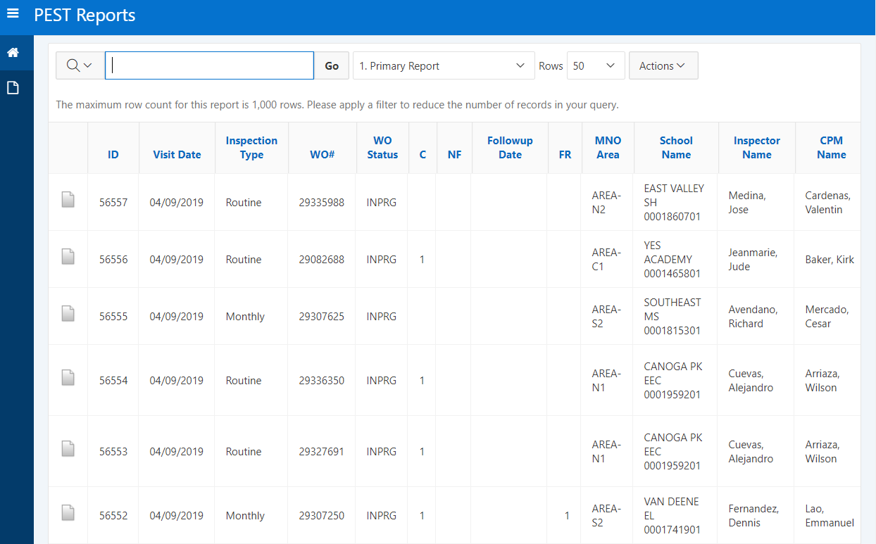
Pest Inspection Reports Home Screen
The home screen will contain a list of all pest reports.
Notes:
READ:

Slide 21
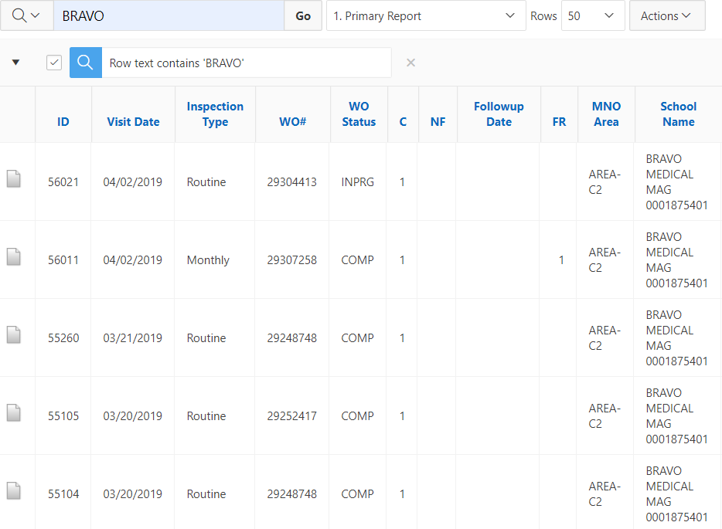
Narrow Search Results to School Site
Use the search feature to narrow the results to an individual school.
Enter the school name then click “Go”.
Notes:
READ:

Slide 22
Pest Inspection Reports
Monthly cafeteria inspections are listed as “Monthly”
Issues reported by school site are listed as “Routine”
Notes:
READ:

Slide 23
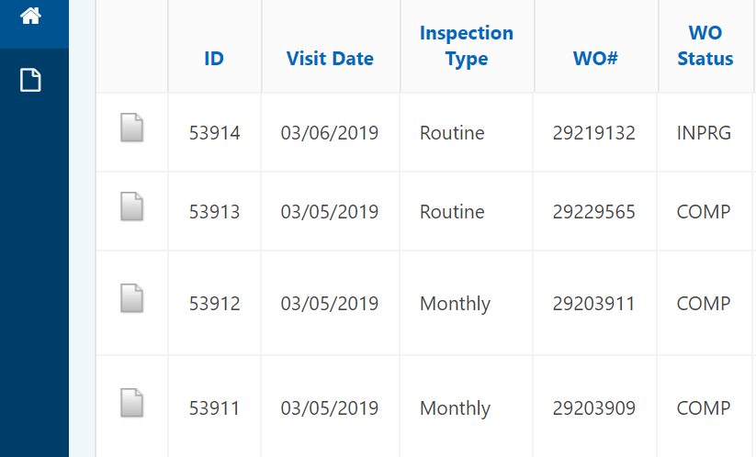
Access Pest Inspection Reports
Once complete, Food Service Managers can access pest reports and review for accuracy.
“INPRG” Indicates the report is still in progress.
Click on the Icon in the left column to access desired report.

Slide 24
Pest Report
The Pest Report is divided into 9 sections.
Inspection Detail
Exterior
Classrooms
Other Areas
Cafeteria
Material Used
FSM Remarks
School Team
View History

Slide 25
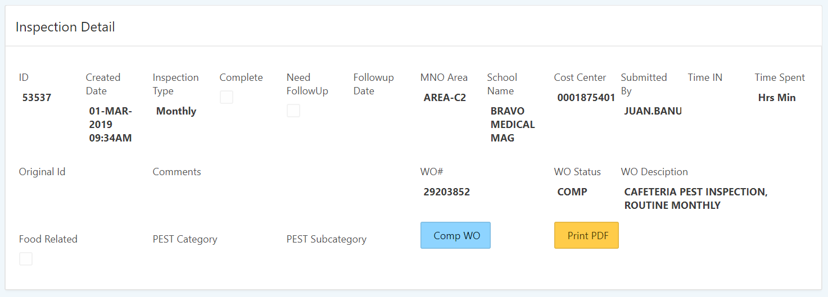
Inspection Detail Section
The Inspection Detail section includes:
Site Information
Type of Inspection
Date of Inspection
Name of Inspector
“Print PDF” Button
Other Pertinent Information

Slide 26
Cafeteria Section
Food Service Manager will review the inspector comments to determine if there is additional information to be noted with the report.

Slide 27
Manager Remarks Section
After reviewing the report the Food Service Manager will enter remarks to indicate any additional information to be noted.
Enter remarks then click the “Add” button to save the entry.
Enter Your Remarks Here
Add

Slide 28
Manager Remarks
SAMPLE REMARKS:
“During inspection manager noticed ants in the cafeteria and informed the inspector. The ants were not cited on the report.”
Manager to submit a M&O request if the inspector has not addressed all cafeteria pest activity.

Slide 29
School Team Section
The School Team section provides the names of the various individuals that have a role in protecting the school site from pest activity.

Slide 30
View History Section
The View History section provides a timeline of who has viewed the report.
AFSS can use this information as a tool to confirm the manager has reviewed and verified the report.

Slide 31
Printing Pest Reports
After the Food Service Manager has verified the report for accuracy and added additional comments, print a PDF copy for the cafeteria file.
Click the “Print PDF” button, located in the Inspection Detail section.

Slide 32
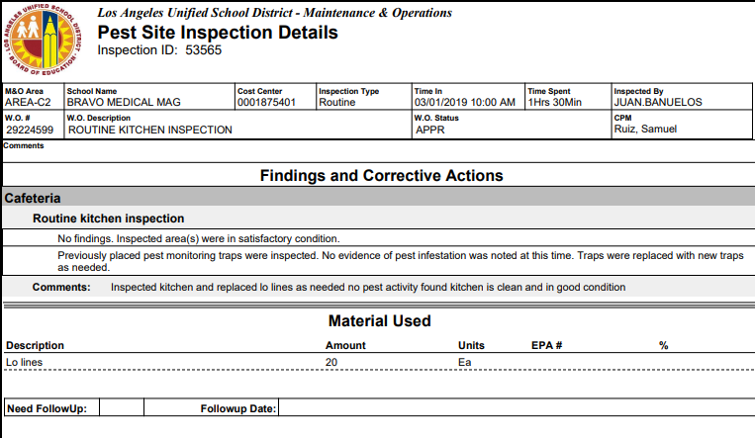
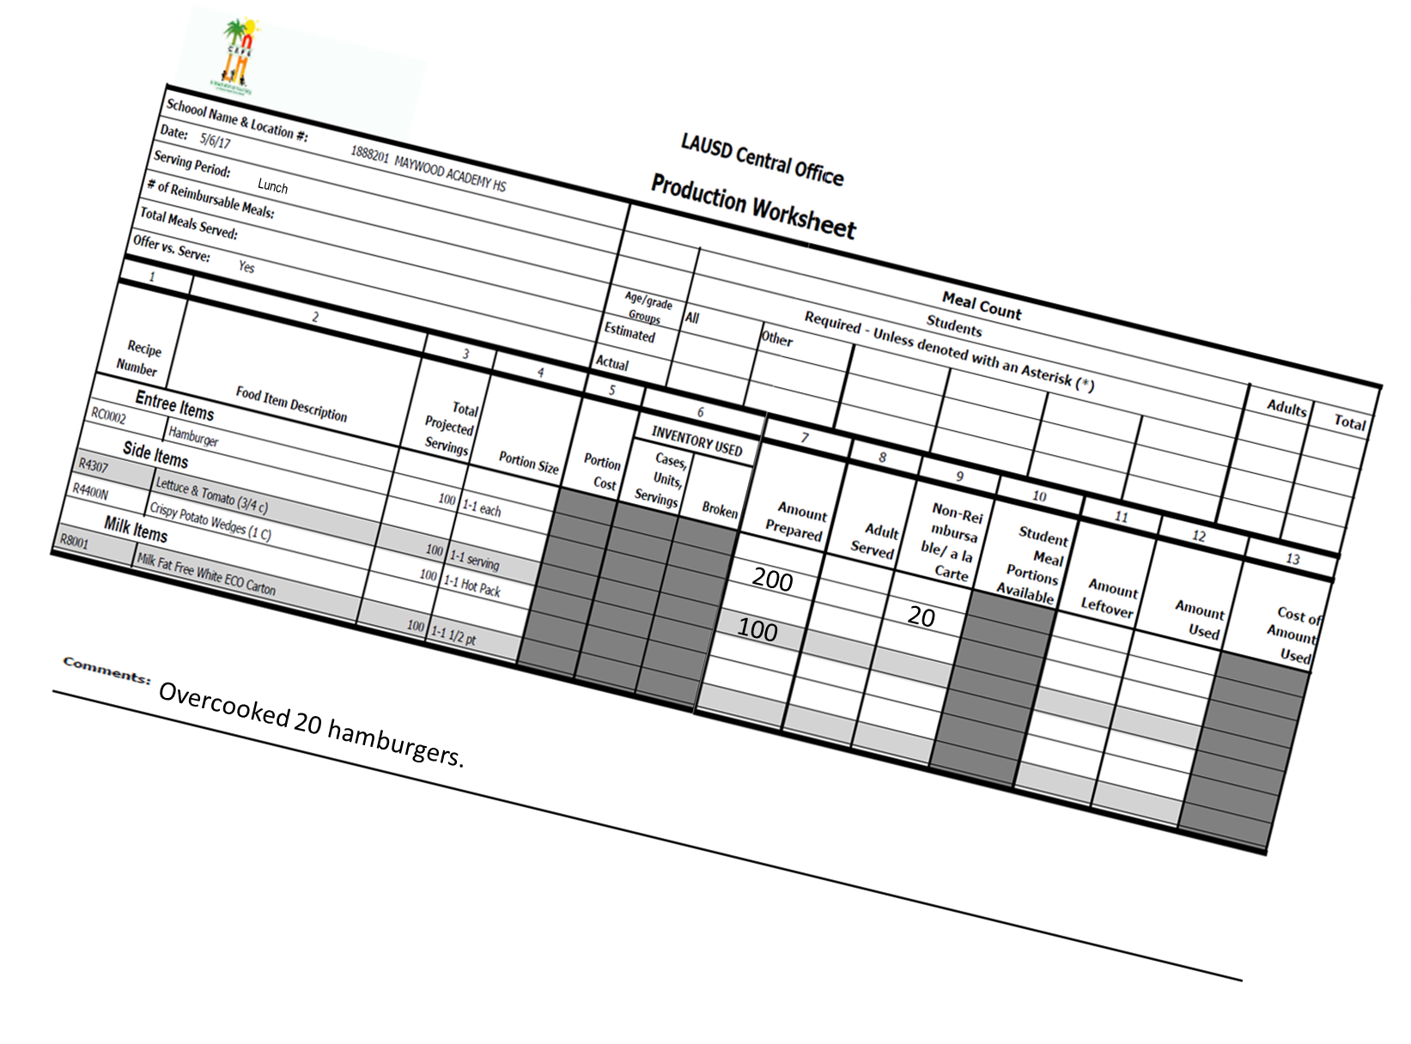
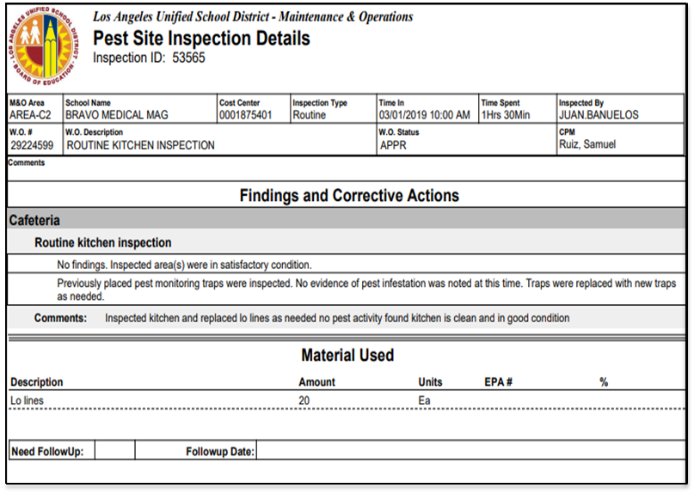
Records Retention Requirements
File all cafeteria pest management reports according to the Records Retention Requirements (Misc. Folder 10).

Slide 33
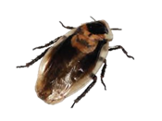
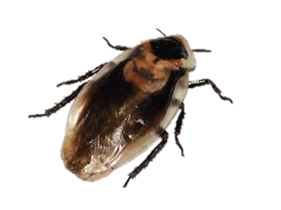
Pest Activity in the Cafeteria
Improperly managed pest problems can lead to health risks for children.
Managers should use the reports as a tool to track pest activity in the cafeteria and corrective actions taken.
Collectively, we can ensure our cafeteria facilities are a pest free environment.

